Slide 1


Big Data Log Management Project
Addressing challenges of collecting and processing logs from containerized applications
Implemented infrastructure to retrieve, send, and process logs
Jules Davoust – Vadim Bernard – Robin Lucas

Slide 2
Summarize
Tools used
Explanation
Conclusion

Slide 3


Tools used

Slide 4




Filebeat
Log Shipper
Lightweight open-source tool by Elastic
Container Logs
Collects logs from Docker containers
Kafka Integration
Routes logs to Kafka for processing

Slide 5

Docker
Containerization
Creates, deploys, and executes applications in containers
Portability
Lightweight, portable environments for applications
Nginx Container
Used to generate logs from standard web server

Slide 6

Vagrant
1
Virtual Environment Management
Creates and manages virtual development environments
2
Automation
Uses configuration files to automate virtual machine deployment
3
Project Setup
Creates VM for Spark, API, and Docker

Slide 7
Apache Spark
Data Processing Engine
Real-time Analysis
Transformation
Fast, large-scale analytical applications
Consumes logs from Kafka
Transforms and analyzes logs in real-time

Slide 8



Apache Kafka
Distributed Streaming
Data Transport
Scalability
Platform for building real-time data pipelines
Transports logs from Filebeat to Spark
Handles publishing, subscribing, storing, and processing data streams

Slide 9

Flask
1
Web Microframework
2
API Development
3
Integration
Lightweight Python framework for web applications
Creates API to expose processed logs and statistics
Easy integration with other Python libraries

Slide 10
Explanation

Slide 11

Environment Configuration
Vagrant
VM creation and resource allocation
Docker
Nginx container setup
Filebeat
Log collection configuration
Spark
Application launch script

Slide 12

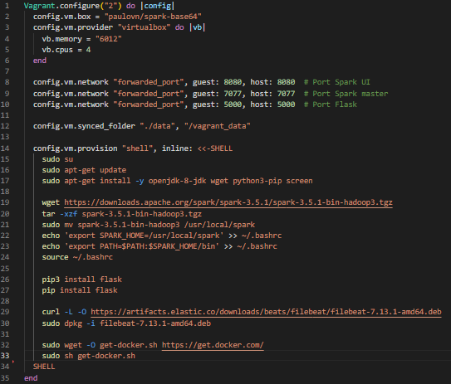
Vagrant

Slide 13
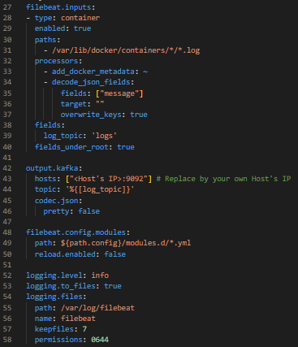
Filebeat

Slide 14
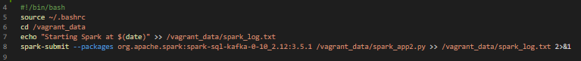
Spark

Slide 15

Kafka and Spark Setup
Kafka Installation
Spark Configuration
Installed and configured on host machine
Set up to consume and process Kafka messages
1
2
3
Topic Creation
Created topic for logs

Slide 16
Kafka Installation
Start Zookeeper
.bin\windows\zookeeper-server-start.bat .config\zookeeper.properties
Start Kafka
.bin\windows\kafka-server-start.bat .config\server.properties
Topic Creation
Create a topic for the logs
.bin\windows\kafka-topics.bat --create --topic logs --bootstrap-server localhost:9092

Slide 17
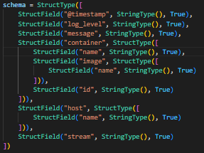
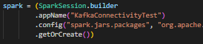
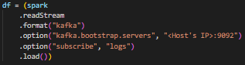
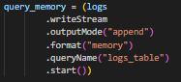
Spark Configuration

Slide 18

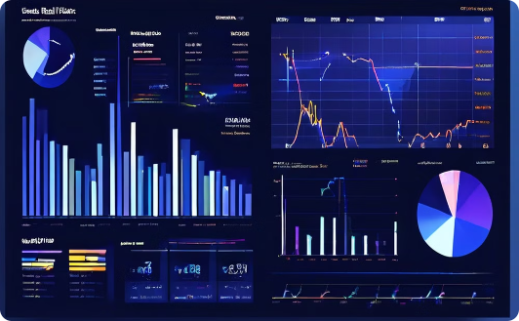
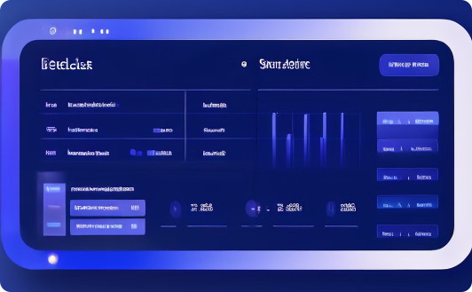
Flask API Development
Endpoints
Data Access
User Interface
Created endpoints for retrieving logs and statistics
Exposes processed data from Spark
Facilitates interaction with log data

Slide 19
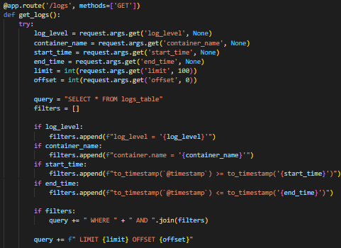
Flask API

Slide 20
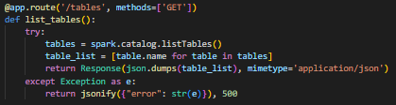
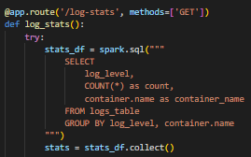
Flask API

Slide 21
Conclusion
Comprehensive Log Management Infrastructure:
We established a comprehensive infrastructure for managing and
analyzing logs in a containerized environment.
Deep Understanding of Technologies:
This project gave us a deep understanding of integrating various
technologies to solve data management problems."
Practical Skills Development:
We developed practical skills in configuring and orchestrating tools
like Vagrant, Docker, Filebeat, Kafka, Spark, and Flask.

